Slide 1
GJK
Additional Details
Game 256

Slide 2
Triple Cross Product Expansion
(A x B) x C = B(C.dot(A)) – A(C.dot(B))

Slide 3
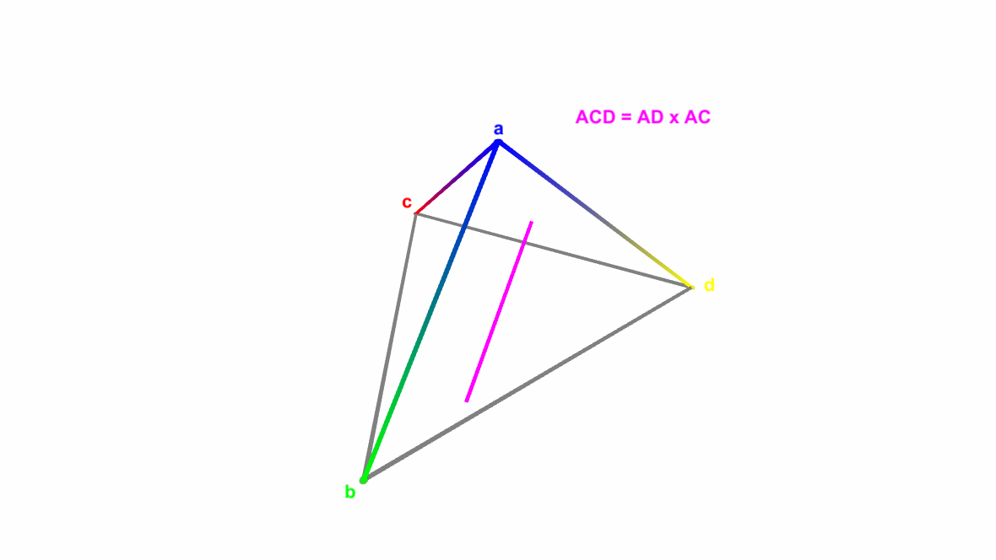
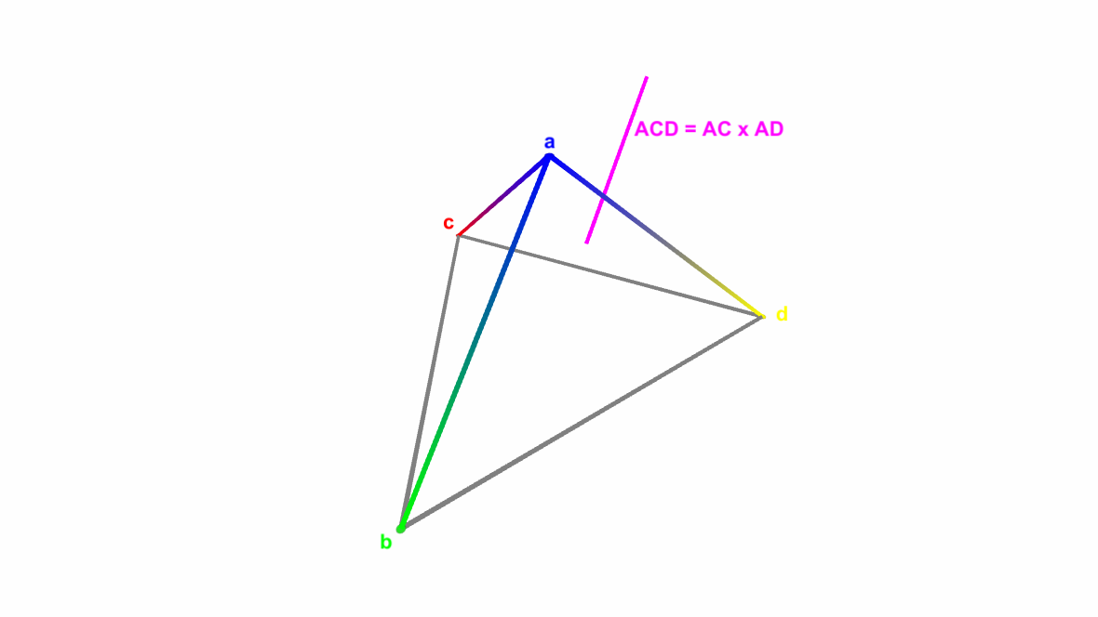
Winding Direction & Cross Product

Slide 4
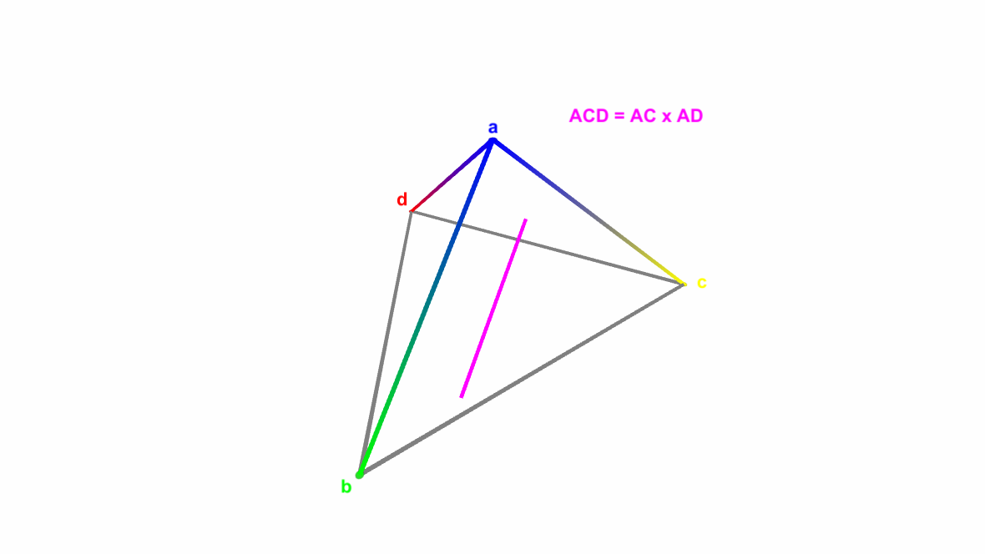
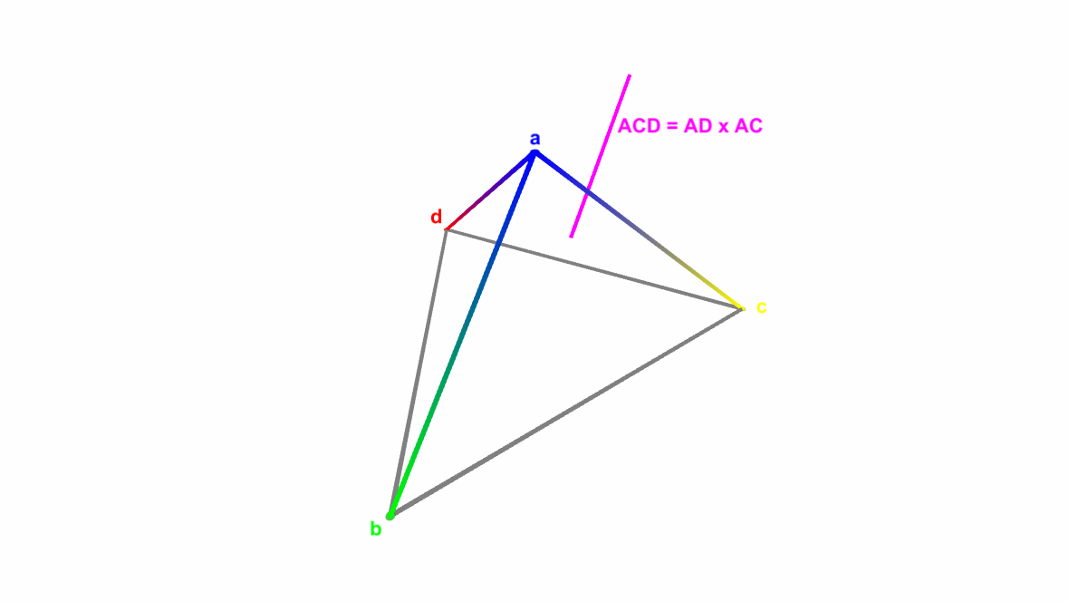
Winding Direction & Cross Product

